Slide 1
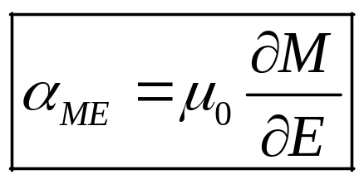
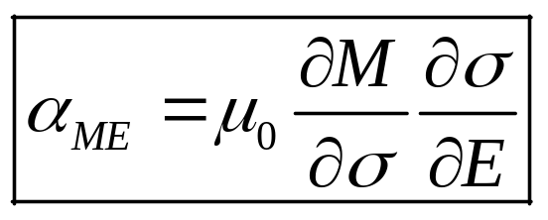
Multiferroic materials and composites
Multiferroic materials
P
M
Multiferroic
E
H
Ferroelectric
Multiferroic
and magnetoelectric
Ferromagnetic
P, M
Multiferroic composites
E, H
Magnetostrictive
Strain/stress
Piezoelectric

Slide 2
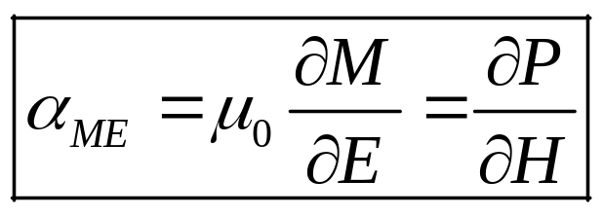
Multiferroic materials
Multiferroic materials can have intrinsic magnetoelectric coupling
E
Piezoelectricity
P
Magnetoelectricity (intrinsic)
Issues for
technological applications
  Room-temperature operation
  Not enough magnetoelectric coupling
  Energy barrier may be too high

M
⬧
H
Magnetostriction
Spaldin et al, Science 309, 391 (2005), Eerenstein et al, Nature 442, 759 (2006)

Slide 3
Multiferroic composites
Multiferroic heteostructures
E
Magnetostrictive
Strain
Piezoelectric
Piezoelectricity
P
Magnetoelectricity (intrinsic)
Enhanced magnetoelectric
coupling by strain

M
Stress-mediated
⬧
H
Magnetostriction
Spaldin et al, Science 309, 391 (2005), Eerenstein et al, Nature 442, 759 (2006)

